Slide 1
Predict Hospital Resources
Team - Abhishek Srivastava, Swati Kumari, Linde Yang

Slide 2
Introduction
Identified Problem Areas:
A Major Challenge in dealing with Corona is Limited Hospital Resources - Hospital Beds, ICU, Ventilators etc.
Impromptu schedules for health care workers.

Slide 3
Introduction
Identified Task:
Predict hospital resources to be required for next day
Impact:
Better Planning of Resources before hand
Doctors can efficiently manage schedules

Slide 4
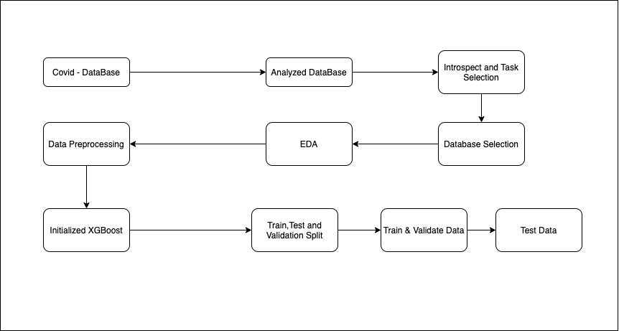
Workflow

Slide 5
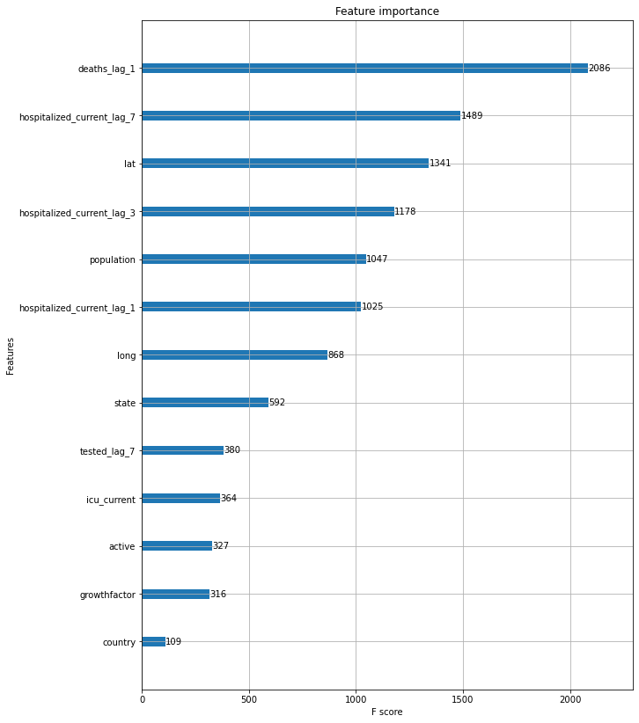
Analysis

Slide 6
Analysis
Most important features are deaths previous day, hospitalization one,three, seven days back, geo-spatial location and population.

Slide 7
Findings
Got a model with rmse score of .39
Could be used to better prepare resources for next day
Management can plan beds and medicines
Doctors can plan their schedule accordingly

Slide 8
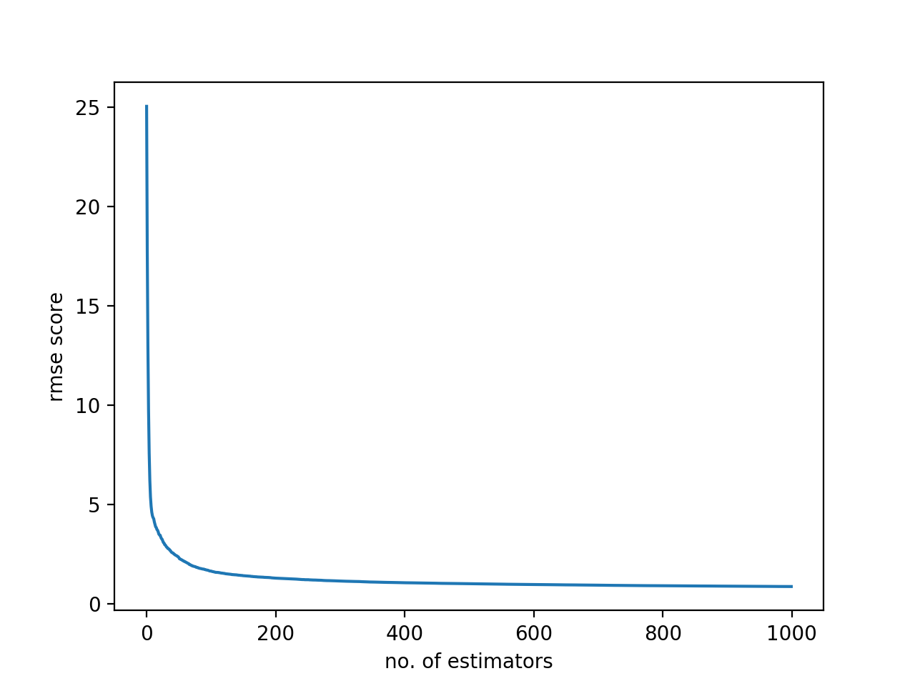
Findings

Slide 9
Future work & Challenges
Future Work:
Could be improved more by utilizing more features but that will require more memory
Extend the model to predict hospital resources for next 7 days
Extend the same idea to explore use of ICUs and Ventilators
Challenges:
A lot of the data was missing
Selecting Database to choose the task

Slide 10
Conclusion
Analysed importance of different factors on Hospital Resources
Created a model which can predict hospital resources for next day

Slide 11
Thank you

